Slide 1

Chemical Footprint Project (CFP) 2020 Report
February 11, 2021
Notes:
Change to Webinar title

Slide 2

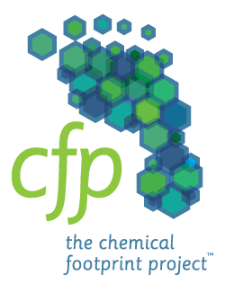


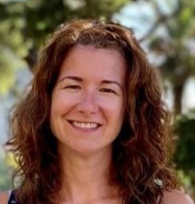


Speakers
Holly Testa
Director of Shareowner Engagement
First Affirmative Financial Network
Cheri Peele
Program Manager
Chemical Footprint Project
Clean Production Action
Jennifer Duran
Global Product Sustainability Director
RB
Mark Rossi
Executive Director
Clean Production Action
Notes:
Speaker headshots
Logistics

Slide 3

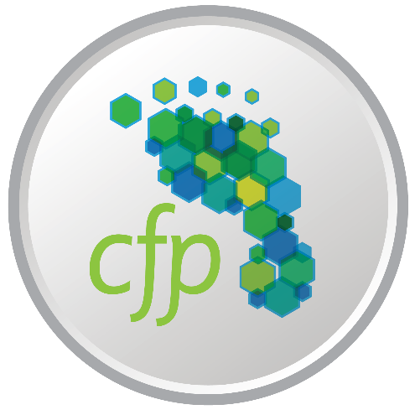

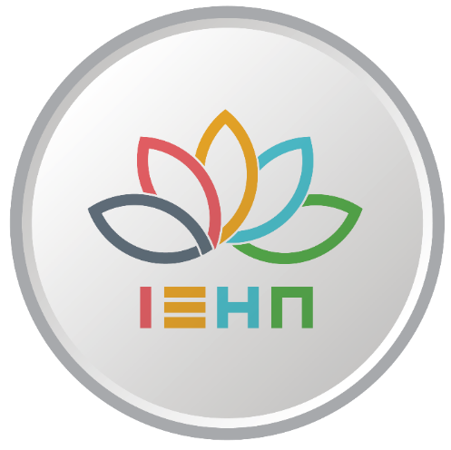
Clean Production Action
Creating solutions for a healthier chemicals economy

Slide 4
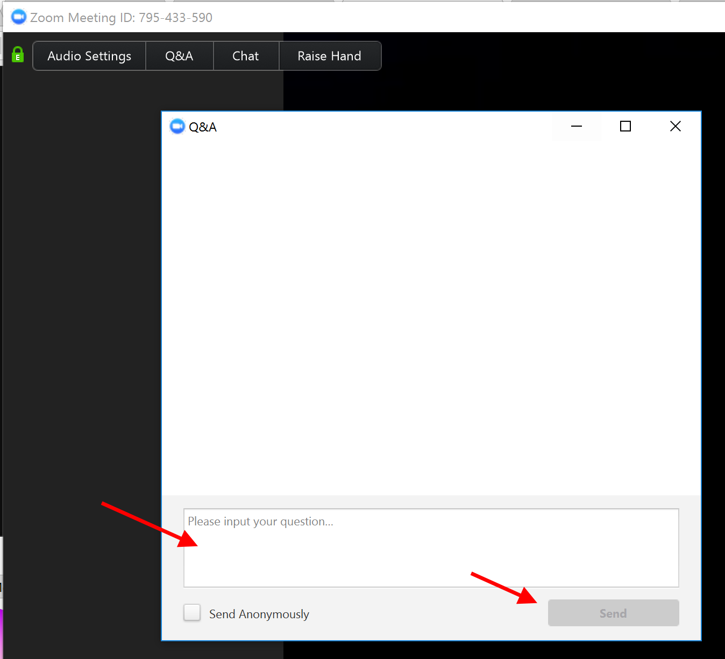
Zoom Protocol
Webinar will be recorded and made available at chemicalfootprint.org
Chat or use Q&A for questions/comments

Slide 5

Copyright: © Jack Brauer
Investor perspective On chemical Risk
Why do we advocate for corporate CFP participation?
Why are our expectations increasing with regard to
Public disclosure of CFP responses and
Public disclosure of CFP Scores responses and score?
Notes:
Thank you,
Opportunity to provide investor perspective
FA is an investment advisor network serving over 400 Investment advisors and their clients. Our mission since 1988 — to improve investment performance, reduce risk and create a better world by integrating sustainable, responsible, and impact (SRI) investing with environmental, social and corporate governance (ESG) principles.
First Affirmative was one of the early investor signatories to CFP, as the mission certainly supported hours.
As I was preparing for this webinar and thinking about how I was going to articulate the investor perspective, the famous Donald Rumsfeld quote popped into my head
-- not someone I recall ever quoting, but quite applicable when it comes to chemicals.

Slide 6
When it comes to chemical risk management…
"There are known unknowns; that is to say we know there are some things we do not know. But there are also unknown unknowns—the ones we don't know we don't know. It is the latter category that tends to be the difficult one. "—Donald Rumsfeld
Notes:
Google quickly informed me that academics studying chemicals made this same leap of thought long before I did. An academic team used the same quote in a paper discussing the challenges of chemical identification back in 2011. There is much we do not know about the material risk of chemicals use, and the impacts of chemical interactions of the many thousands in use fall into to both of Mr. Rumsfeld’s cataegories.
When we first became a signatory of the CFP project, few if any Companies and their investors even had adequate tools to effectively evaluate, measure and manage chemical risks much less report on them. Our priority initially was to better understand what good chemical management process and policy even looks like.
As the CFP survey has matured, expanded, and effectively aligned with the Sustainable Accounting Standard Board’s framework, so too has our ability to assess our portfolio companies.
The rapid adoption by investors of SASB as a baseline expectation for reporting on material sustainability issues should be a wake-up call to companies. Investors want to know where businesses stand with regard to managing financial risks of hazardous chemicals in their products and supply chains. Investors also increasingly expect companies to implement plans that put them on a path towards safer chemicals use.

Slide 7
Investors expect disclosure according to...
… CFP is the right tool for the job
7 SASB Standards ID chemical risk
Building Products & Furnishing
regulatory risk
reputational risk
Toys and Sporting Goods
regulatory risk
reputational risk
social license to operate
SASB accounting metrics
Processes to assess/manage risk associated with chemicals in products
Percentage of eligible products meeting VOC emission and content standards
Number of recalls and units recalled
Number of letters of advice received
Monetary losses from product safety associated legal proceedings
Processes to assess/manage risk associated with chemicals in products
Notes:
Let’s take a quick look at a couple of sectors out of the seven where the SASB framework asks for specific chemical disclosure.
The SASB standard for the Building Products & Furnishing sector highlights that
companies in this sector are “exposed to potentially significant regulatory and
reputational risk as a result of the use of substances of concern.”
Toys & Sporting Goods standards emphasize that the failure to manage hazardous chemicals in products may “impact a company’s social license to operate.”
For all seven predominantly consumer facing sectors, Regulatory and reputational risks, along with growing consumer pressures, dominate SASB’s materiality issues for chemicals in products.
On the flipside of risk is opportunity- managing these risks leads to competitive advantage over the long-term-through higher demand, reduced regulatory risk, enhanced brand reputation.
The CFP survey provides companies with an effective tool that supports SASB compliance and helps them to meet investor demand for comprehensive reporting.

Slide 8
CFP: Blueprint for Engagement
Notes:
I have pulled this next slide directly from the survey report, as it clearly articulates the value of the survey to support investor engagement.
Our engagement with companies encompasses all of these points,
but with many companies the conversation is too focused on this last point of elevating the importance of corporate disclosure of chemicals management policies, procedures, and practices.
We cannot drive deep systemic change until our engagement is able to shift from convincing a company to adopt the CFP survey to using the survey results to drive continuous improvement. There also needs to be a critical mass of companies systematically and fully disclosing the relevant data. The CFP can then reach its full potential as a benchmark.
Ultimately, First Affirmative would like to see all companies with material chemical exposure to set public goals to measure, disclose, and reduce their chemical footprints in the same way many companies are measuring and reducing carbon footprints via the CDP platform. This will be the next exciting frontier.
We invite other investors to support the work and for companies to commit to the CFP.

Slide 9
Impact
First Affirmative Financial Network, LLC (Registered Investment Advisor, SEC File #801-56587). The opinions and concepts presented are based on data believed to be reliable; however, no assurance can be made as to their accuracy. Mention of a specific company or security is not a recommendation to buy or sell that security. Past performance is never a guarantee of future results. For information regarding the suitability of any investment for your portfolio, please contact your financial advisor.
The views expressed herein are those of First Affirmative and may not be consistent with the views of individual investment advisors or Broker-Dealers or RIA firms doing business with First Affirmative. Network Advisors may offer securities through various Broker-Dealers and Registered Investment Advisory firms. These affiliations, and all fees charged to clients, are clearly disclosed.
Dedicated to the belief in the power of capital to bring lasting environmental and social change

Slide 10
Chemical Footprint Project Survey
Fifth Annual Report
Front-runners in Chemical Footprinting
February 11, 2021

Slide 11
Outline
Why a chemical footprint?
Overview of CFP Survey
Results
Next steps

Slide 12
Why a chemical footprint?
“A large and growing body of evidence shows beyond any shadow of a doubt that toxic chemicals can cause a range of diseases that include cancer, diseases of the heart and lungs, and reproductive impairment.
Prevention of these impacts is most effectively achieved by phasing out the use of toxic chemicals.”
Philip Landrigan, MD
Director of the Program Global Public Health and the Global Observatory on Pollution and Health
Boston College

Slide 13
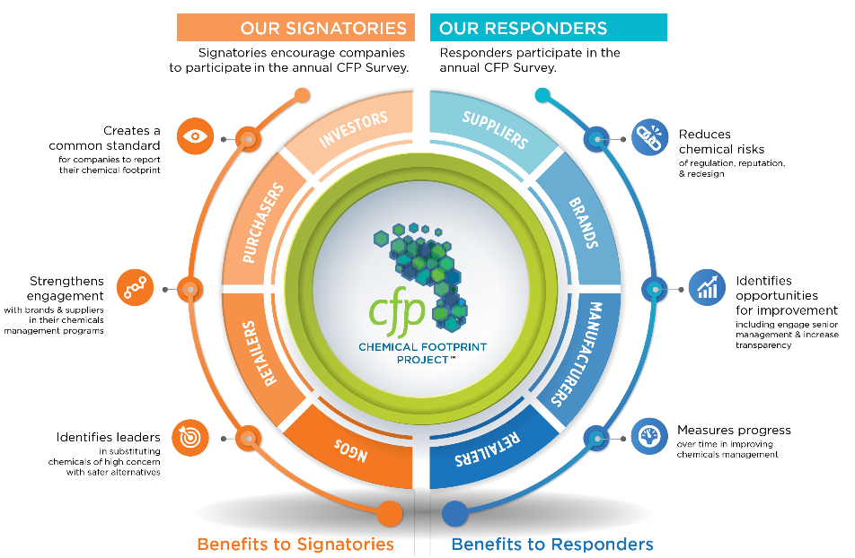
CFP Signatories
Investors represent over $2 trillion in assets under management
Health care & retail signatories represent over $800 billion in purchasing power
Notes:
Cut in half

Slide 14
CFP 2020 Survey Responders
Apparel & Textiles: Standard Textile Co.
Building Products & Textiles: Andersen Windows, Construction Specialties*, Herman Miller, Inc.*, HNI Corporation, Humanscale*, Kohler Co.*, Milliken & Co.*, Naturepedic
Household & Personal Products: Beautycounter, The Clorox Company*, Diversey, Inc., Ecolab Inc., GOJO Industries, Kimberly-Clark Corporation*, Meliora Cleaning Products, Reckitt Benkiser Group plc (RB)*, Seventh Generation
Medical Equipment & Supplies:
Becton Dickinson and Co. (BD), Steris PLC*
Technology: HP Inc.
Retail: Ahold Delhaize*, Dollar Tree, Inc.*, Grove Collaborative*, Target Corporation, Walmart*
Toys: Hasbro, Inc., Radio Flyer
Anonymous: 5 companies
* Did not report on full product portfolio
Notes:
Cut in half

Slide 15
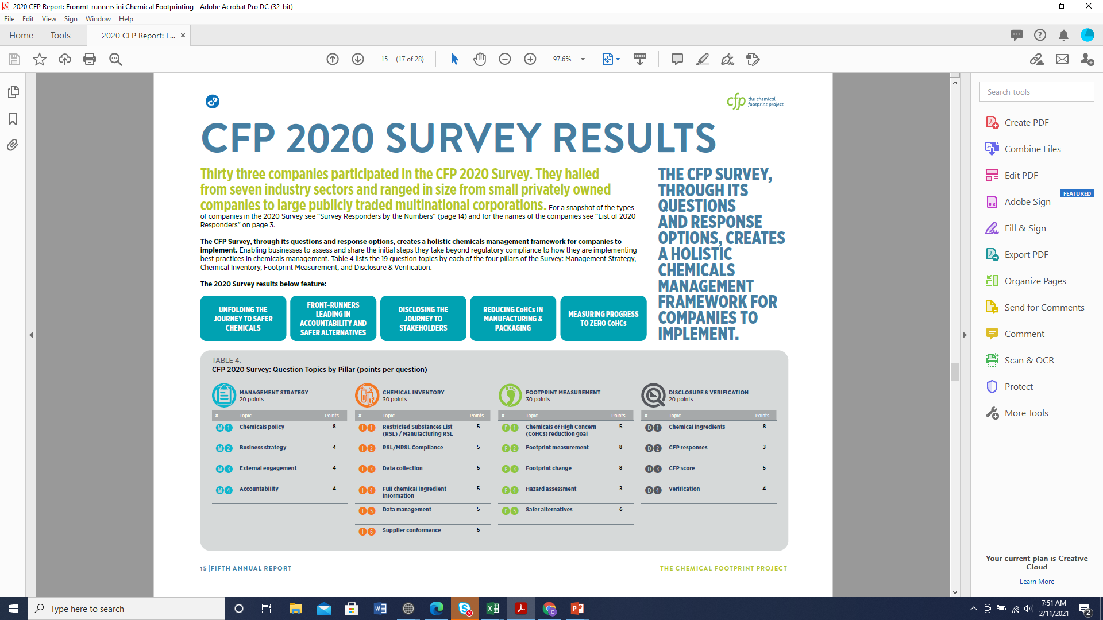
CF
CFP Survey:
Four Pillars
Notes:
Use table 4

Slide 16
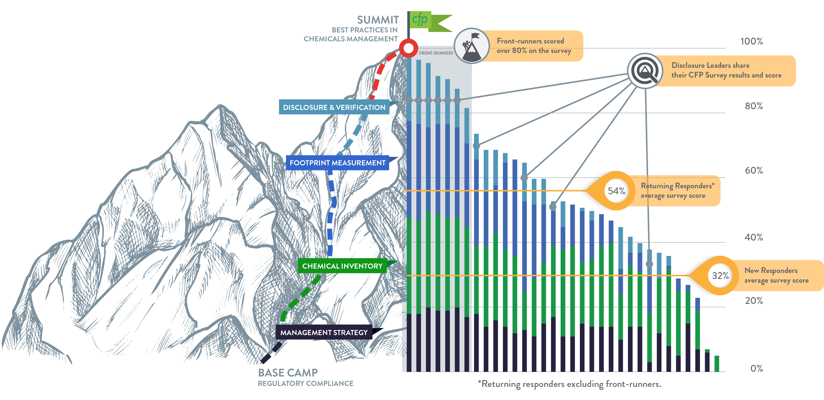
CFP 2020 Survey Scores
Front-runners
Returning
New

Slide 17
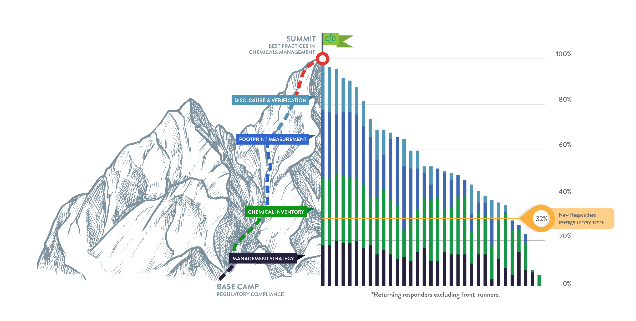
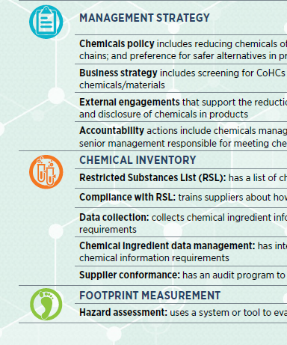
New responders
32%

Slide 18
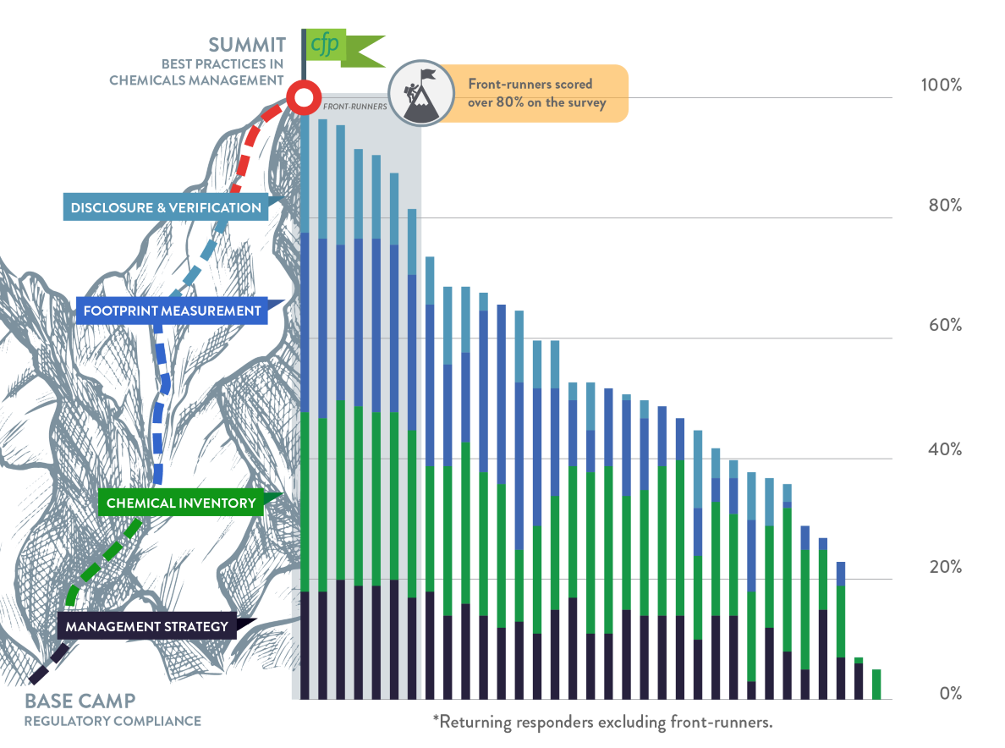
Front-runners
>80%
Beautycounter
Herman Miller
HP
Humanscale
Naturepedic
RB
Seventh Generation

Slide 19
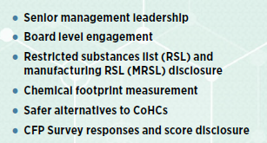
Front-runners
>80%

Slide 20
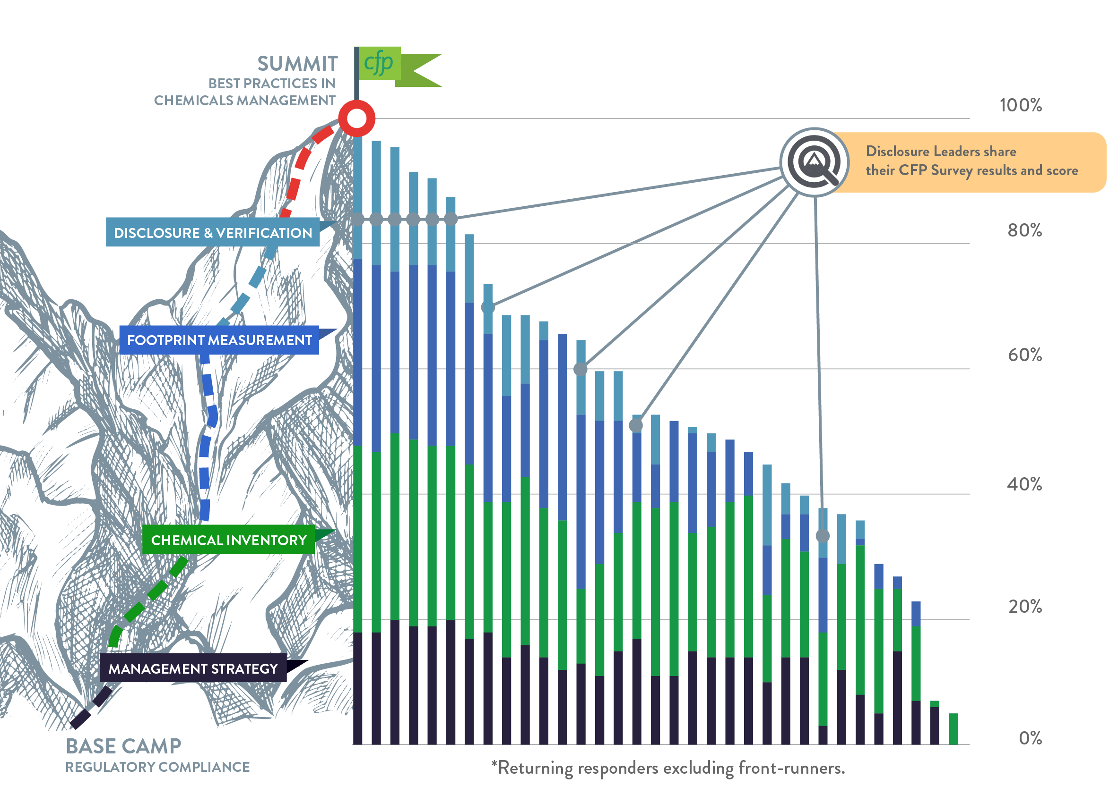
Disclosure Leaders
Beautycounter
BD
GOJO
Herman Miller
HP
Humanscale
Naturepedic
Seventh Generation
Walmart
https://www.chemicalfootprint.org/results/disclosure-leaders
Notes:
Framework for telling your story within framework validated by others
Internal benchmarking, e

Slide 21
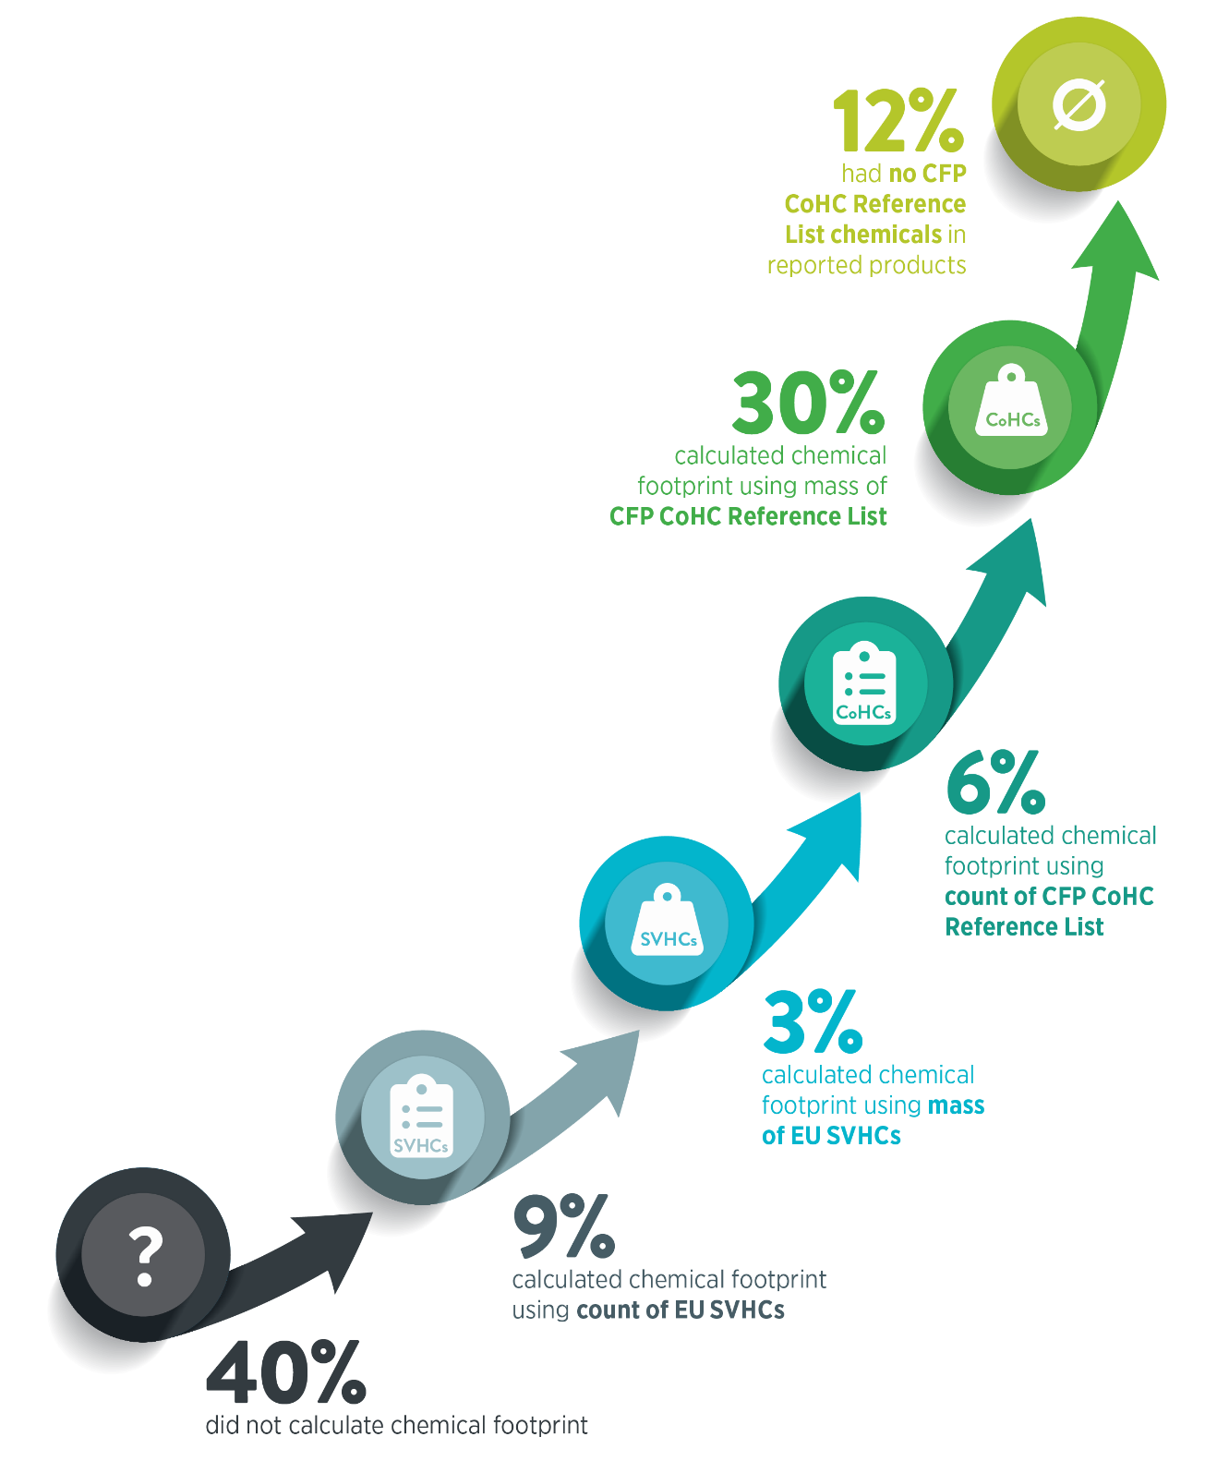
Chemical Footprinting
Calculate by:
Count or mass
Short or long reference list
  European Union Candidate List of Substances of Very High Concern (~200)
  CFP Chemicals of High Concern (~2,200)

Slide 22
Engage with stakeholders: Share your journey
Customers Investors Advocacy groups
CFP 2021 Survey opens: March/April 2021
CFP 2021 Survey closes: June/July 2021
CFP 2021 Report: Q4 2021/Q1 2022
Notes:
Open: March/Apr
Close: end of Q2
Report: Q4/Q1

Slide 23
Acknowledgements
Sally Edwards
CPA: Olivia LaMarche, Kayla Williams, Ellen Goldberg
Ali McPherson & Investors Environmental Health Network
Mellissa Nguyen & Vizient
Monty Lewis
Evelyn Ritter, Juliet Siebel & Toxnot staff
Boma Brown-West & BizNGO Chemicals Management Work Group
Pure Strategies, WAP Consulting
Western NY Sustainable Business Council
CFP Responders & Signatories
Bree Rodrigues

Slide 24
Introducing RB
Jennifer Duran
Global Director, Product Sustainability
Chemical Footprint Project
11 February 2021

Slide 25
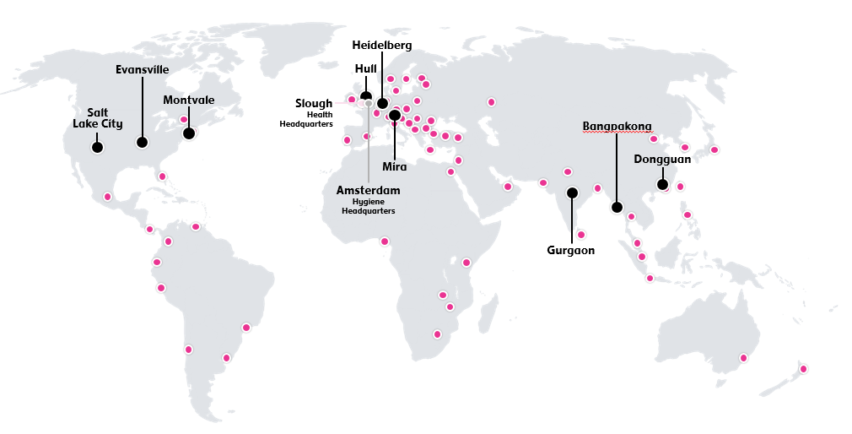
At a glance
RB in numbers
3
20m+
42,000+
200+ year
business units
products sold daily
employees
heritage
£12.8bn
16
42%
60
countries across six continents
Net Revenue in 2019
+0.8% LFL growth
Reported growth +2%
consecutive years as a member of the FTSE4Good Index
reduction since 2012 in Greenhouse gas emissions per unit of production
Notes:
Our Purpose
To protect, heal and nurture in
the relentless pursuit of a cleaner,
healthier world
Our Fight
Making access to the highest quality
hygiene, wellness and nourishment
a right, not a privilege

Slide 26

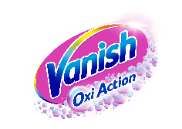
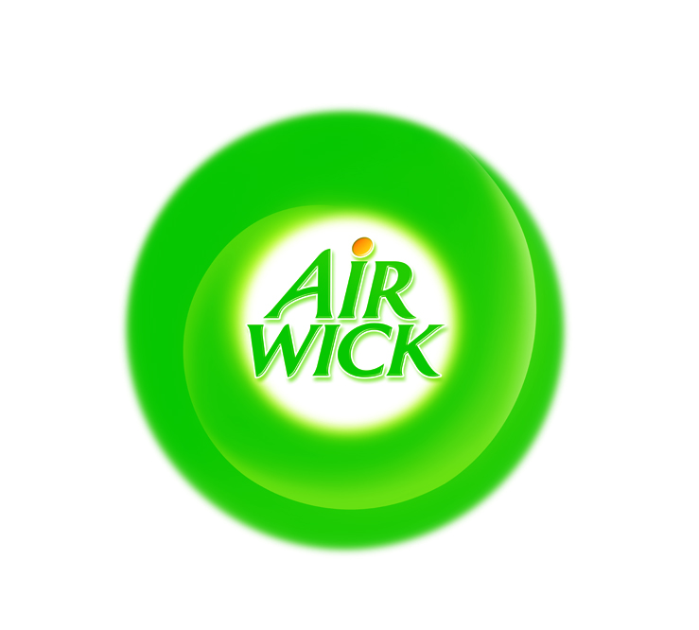
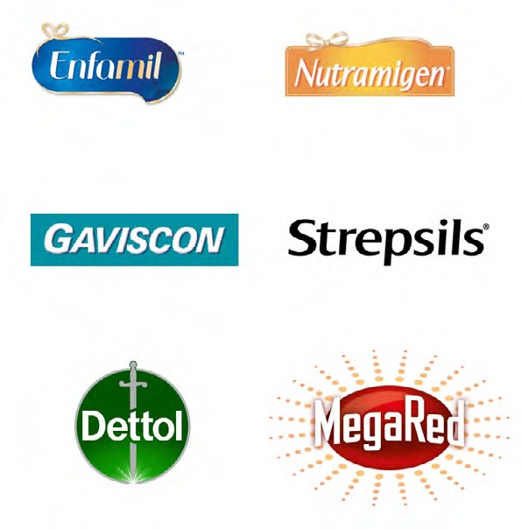

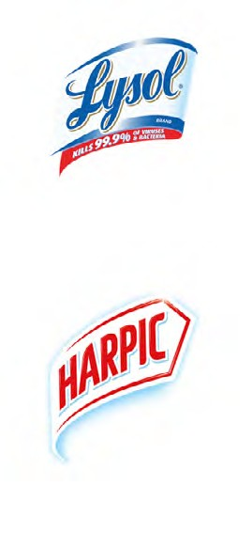



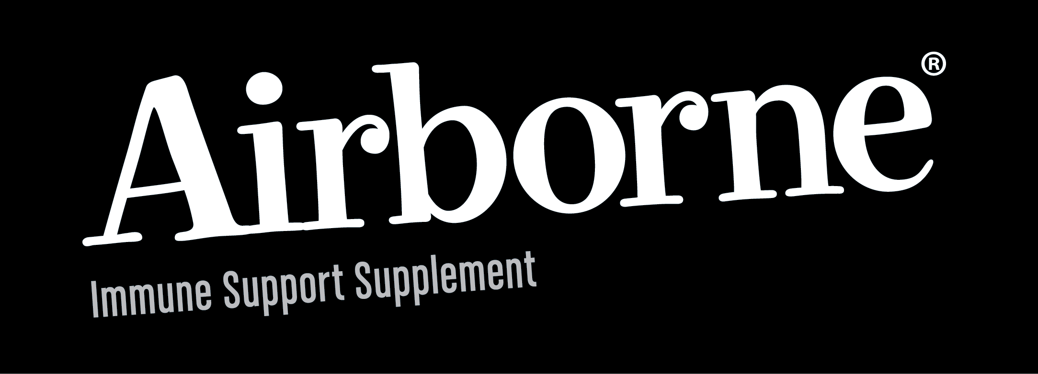


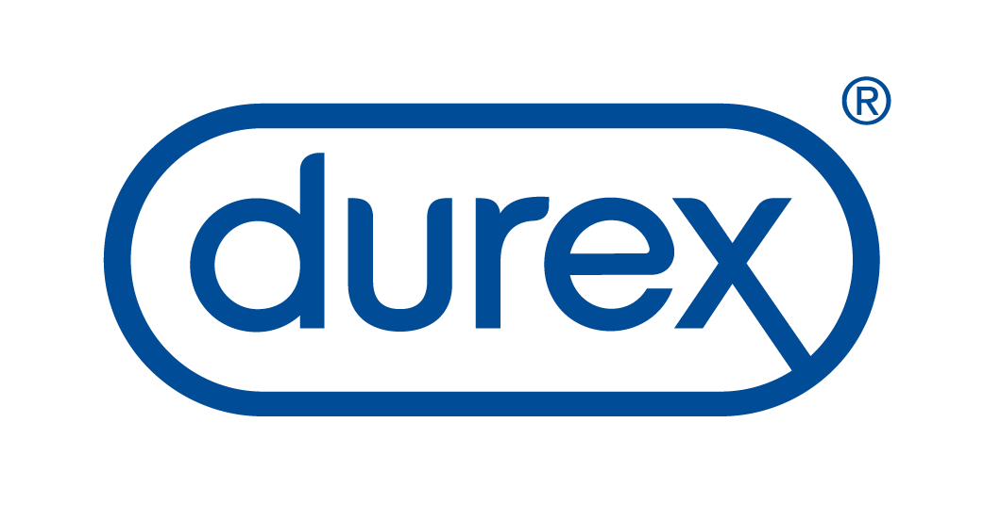
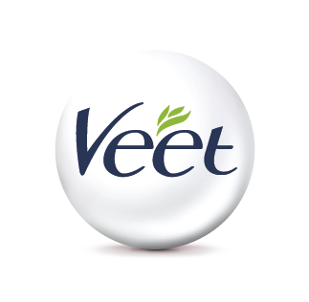

Organised for growth
3 category-focused global business units
Hygiene
Health
Nutrition
For a pest, odour,
germ and dirt-free world
A healthier world powered by self-care, hygiene, sexual wellbeing and wellness
Nutrition for every stage of life
With a cross-portfolio focus on Greater China, digital and ecommerce

Slide 27
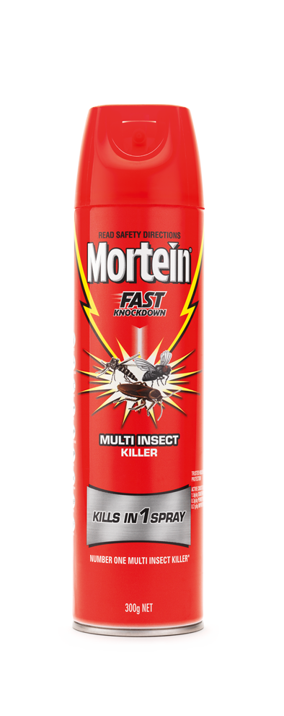
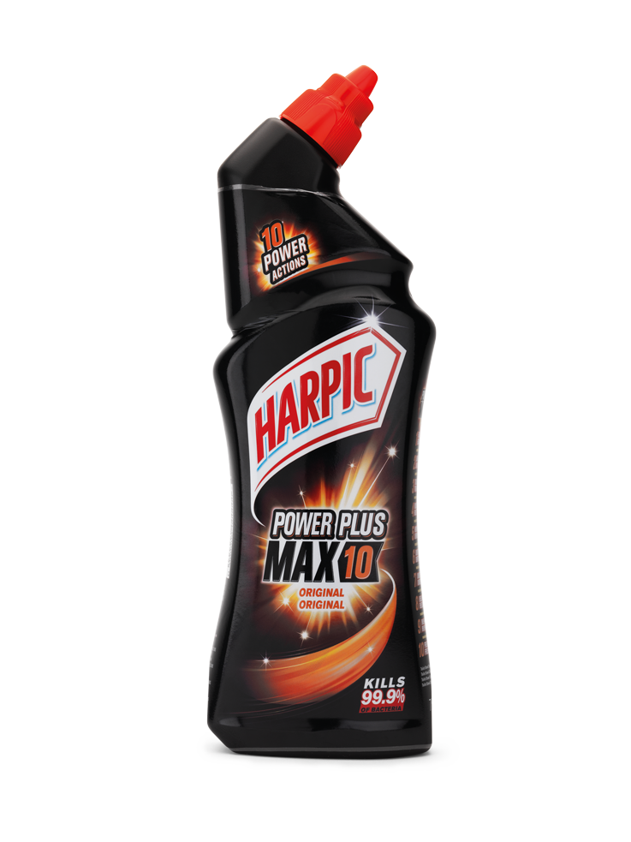
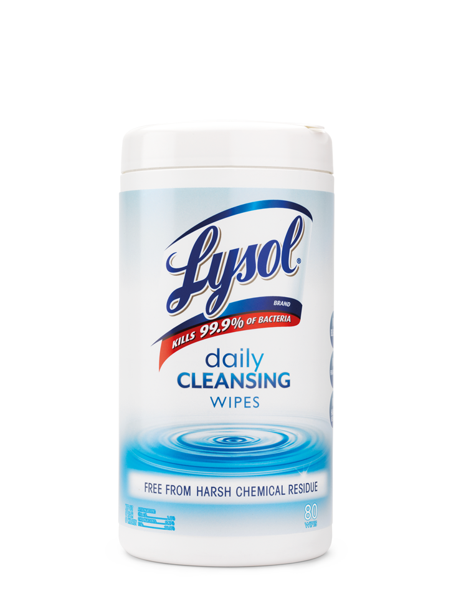
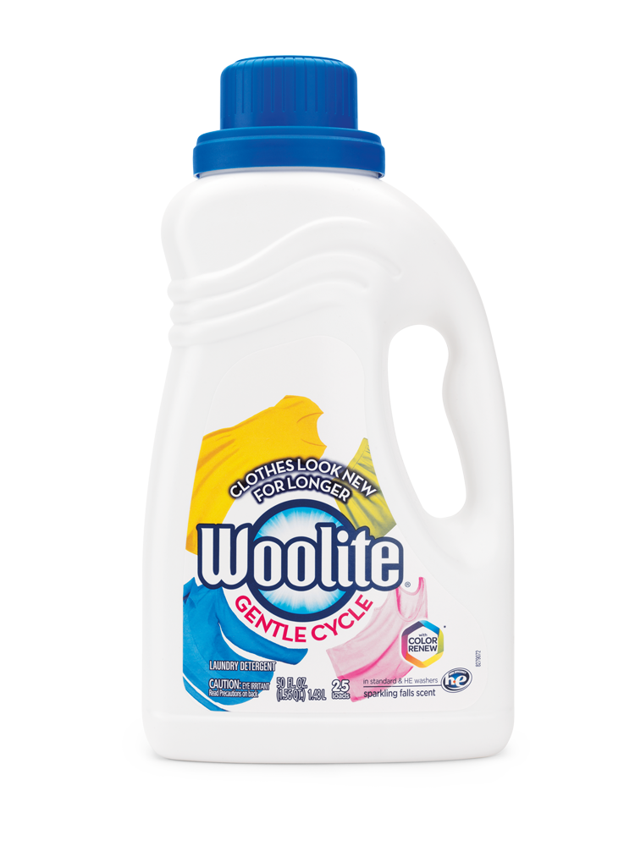
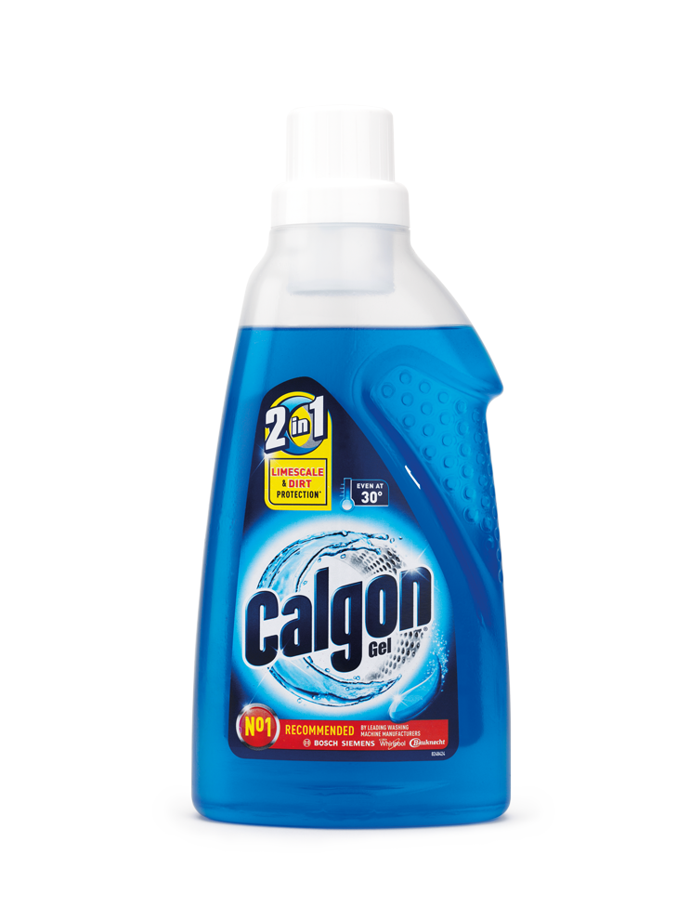
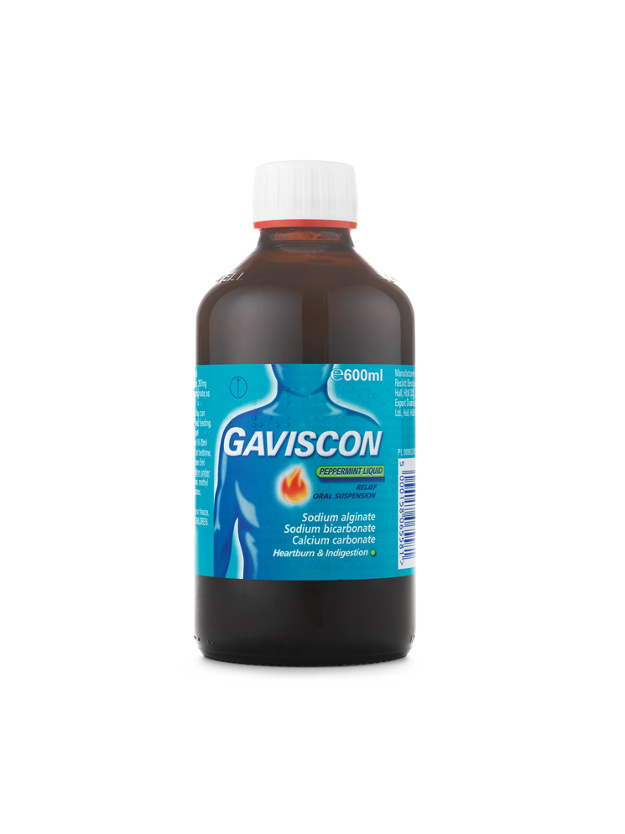
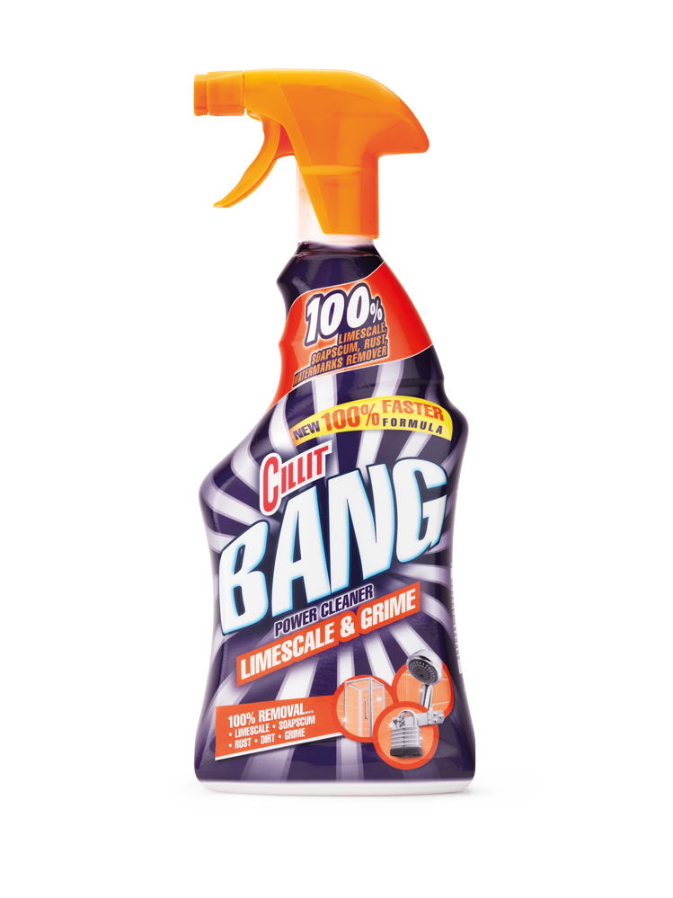

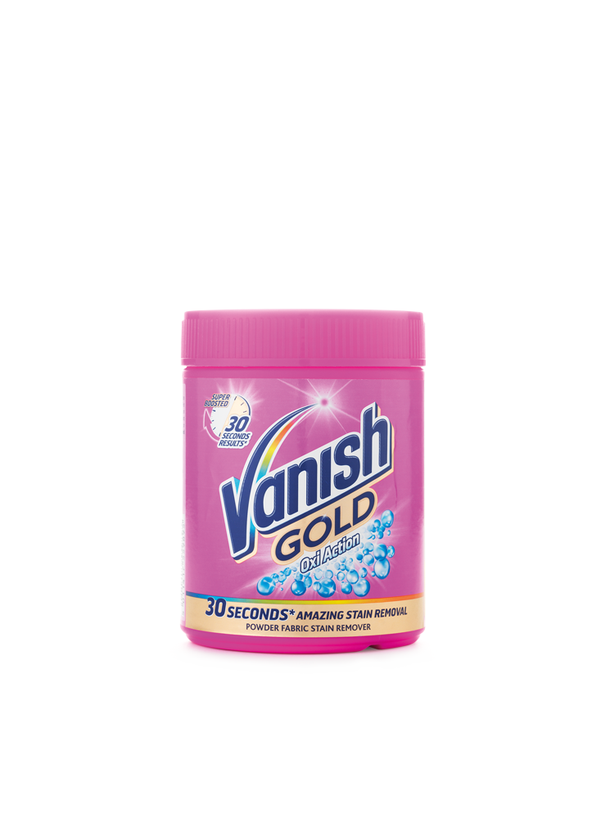
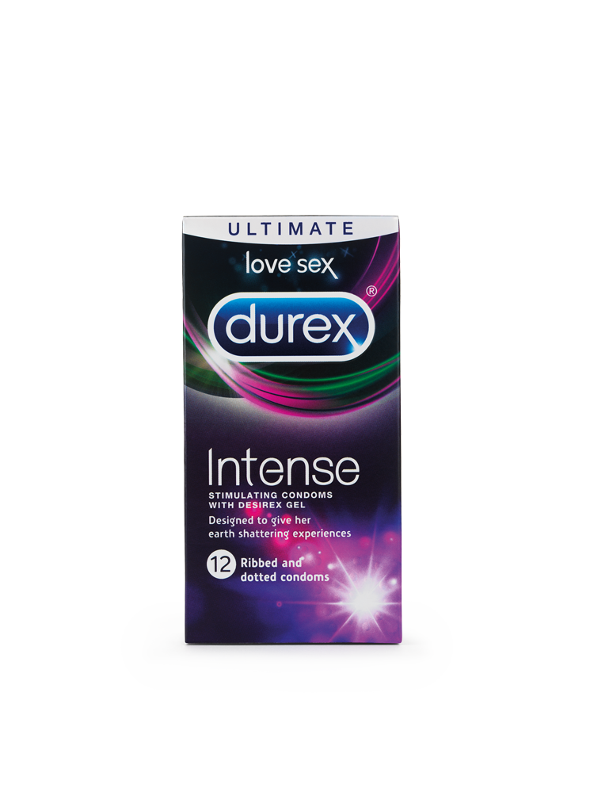
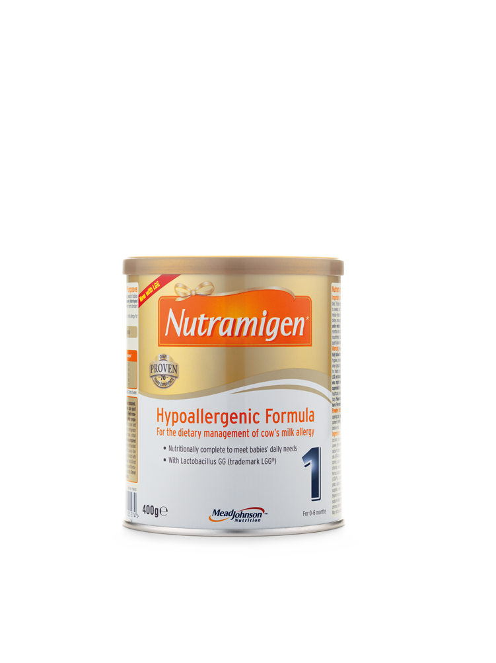
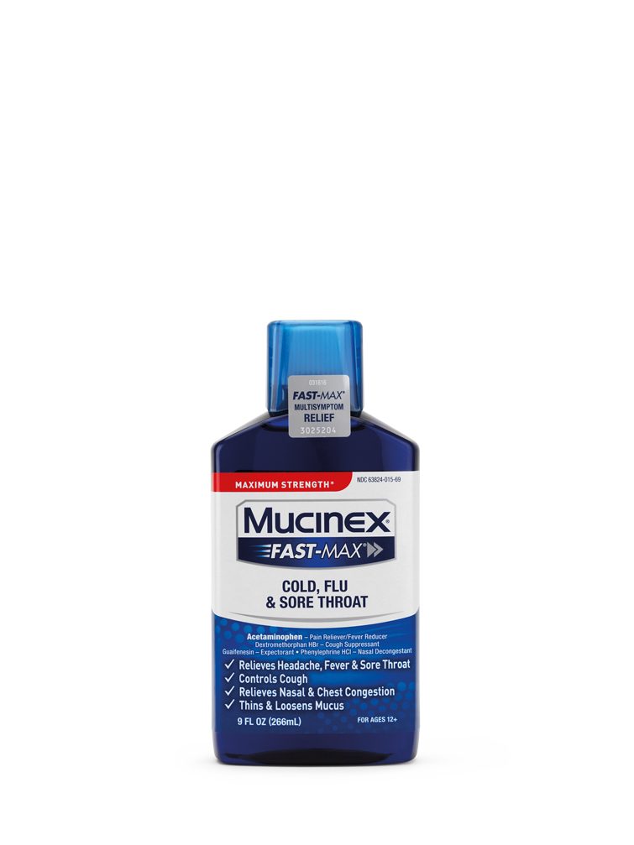
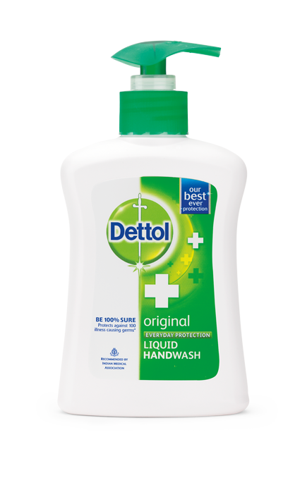
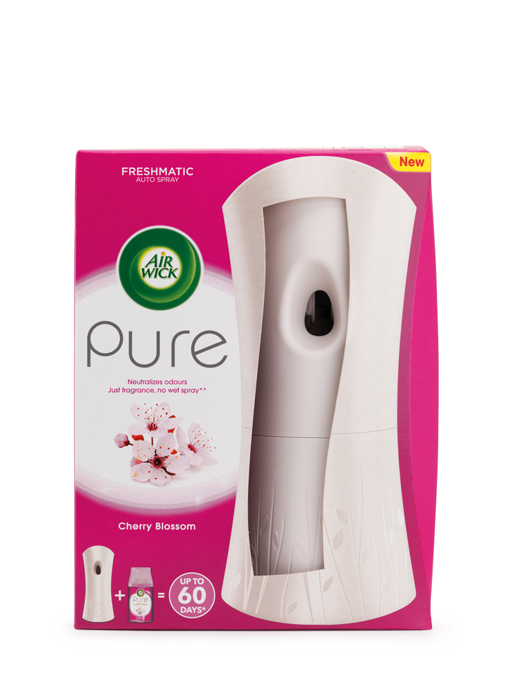
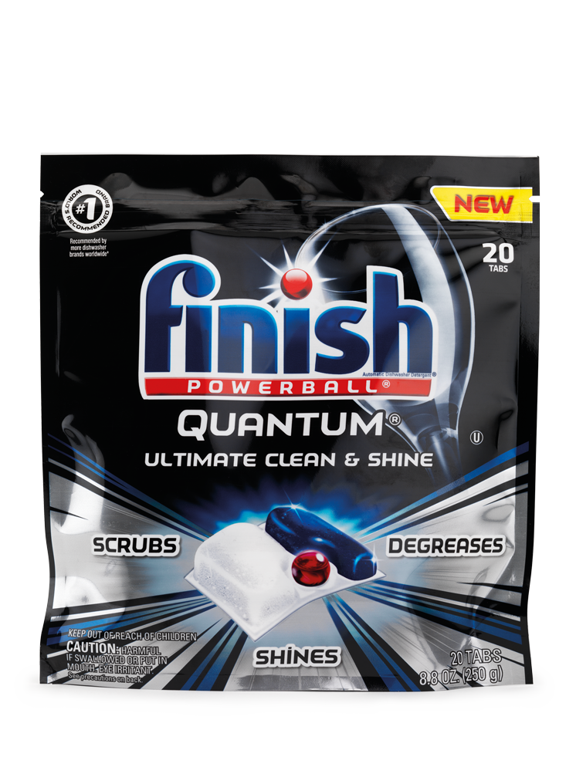

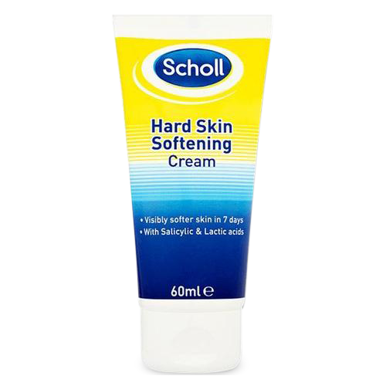
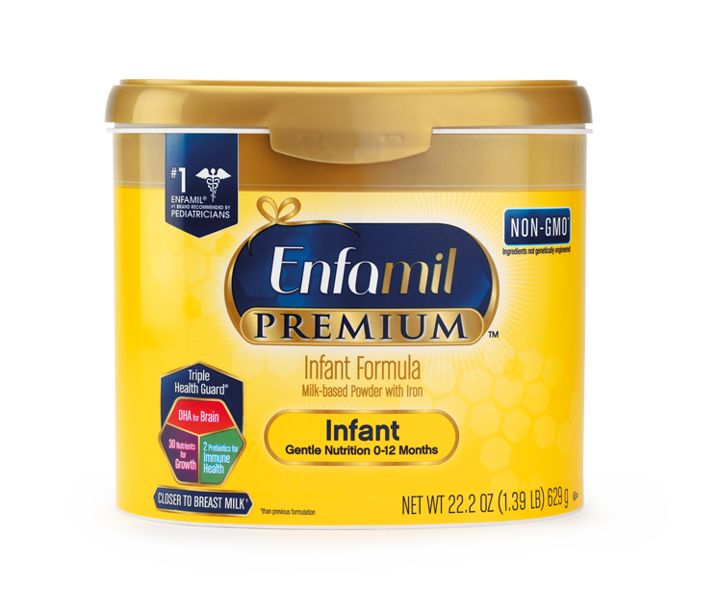
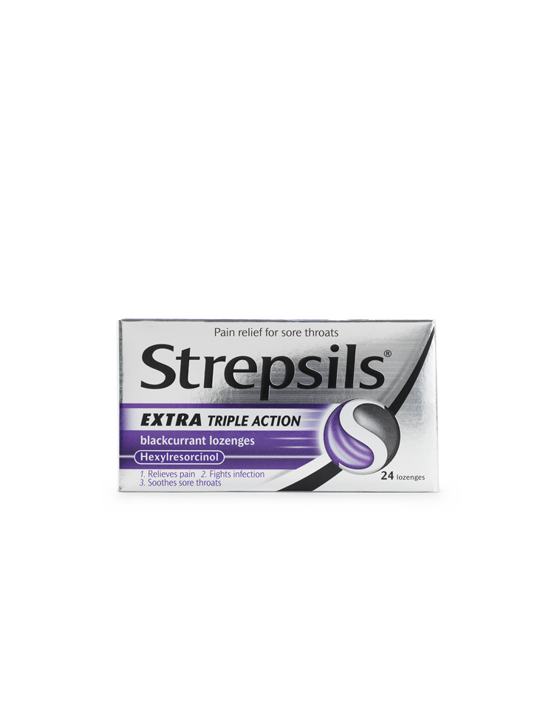
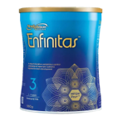
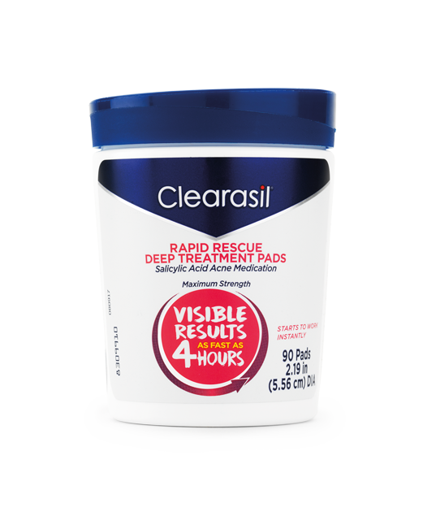
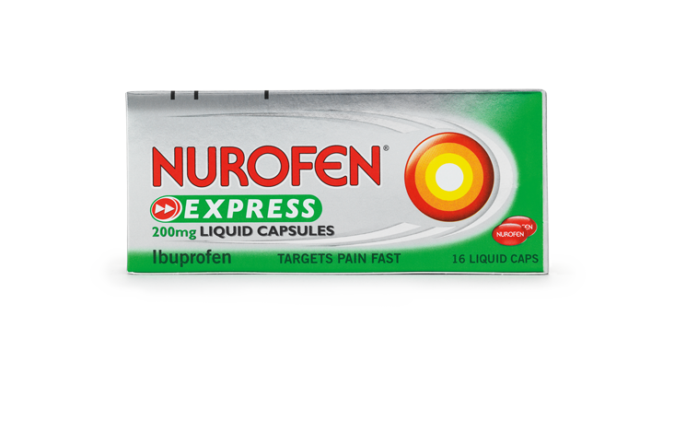
Long standing, trusted brands
Good house
Mortein launched
1880
Scholl launched
1904
Harpic
launched
1923
Dettol
launched
1932
Air Wick
launched
1943
Finish
launched
1953
Strepsils
launched
1958
Clearasil
launched
1959
Nurofen
launched
1983
Mucinex
launched
2002
Enfinitas
launched
2016
Botanica
launched
2020
1819
Lysol
launched
1889
Veet
launched
1922
Durex
launched
1929
Nutramigen
launched
1942
Woolite
launched
1951
Calgon
launched
1956
Enfamil
launched
1959
Gaviscon
launched
1965
Vanish
launched
1983
Cillit Bang
launched
2004
Neuriva
launched
2019

Slide 28
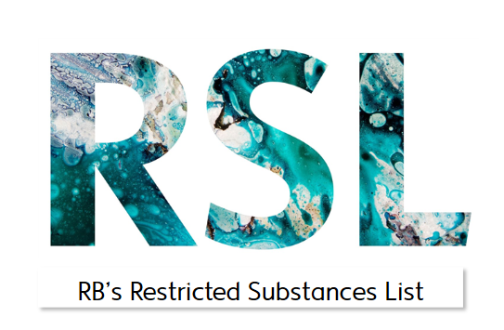
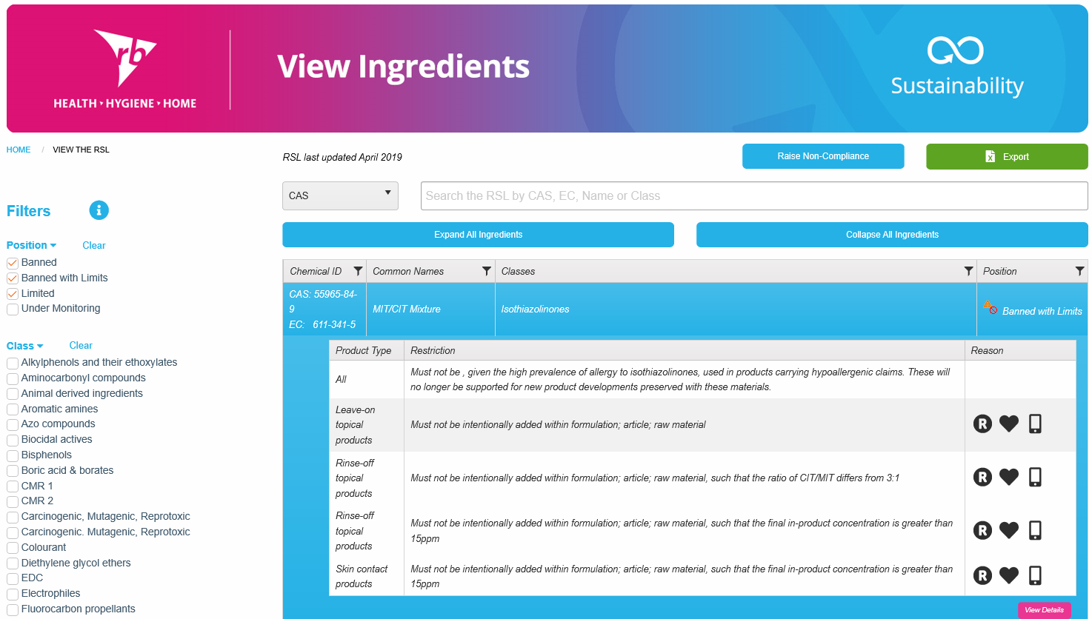
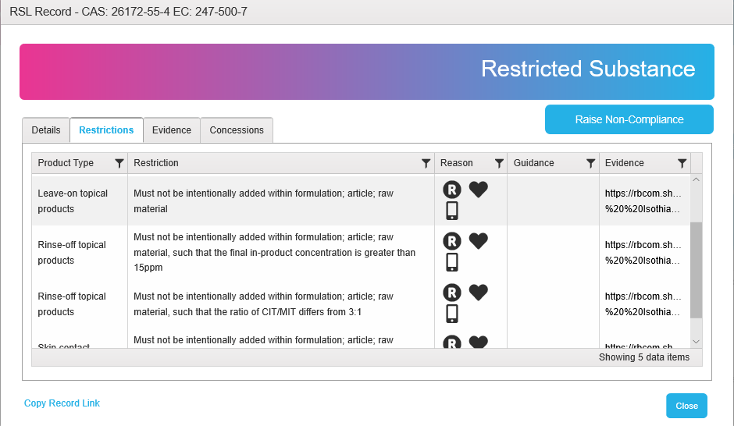
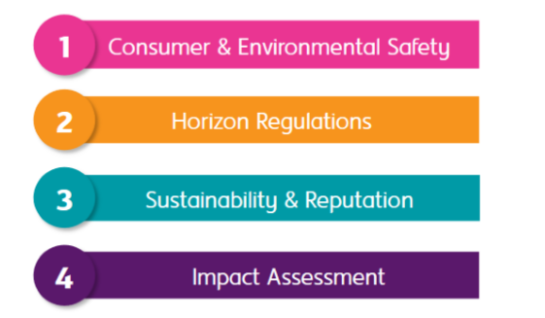
What is the RSL
How it works
Regular review
RSL is a key strategic enabler that ensures a consistent, global approach to safeguarding our consumers & employees from exposure to ingredients of potential concern.
Public Policy here
The RSL defines ingredients that are banned or restricted in our global product portfolio.
Restrictions vary depending on the type of product and exposure.
New ingredients of concern that emerge undergo a 4 pillar review at Ingredient Steering Group (ISG)
Notes:
Proactive Chemical Management via ISG and RSL

Slide 29
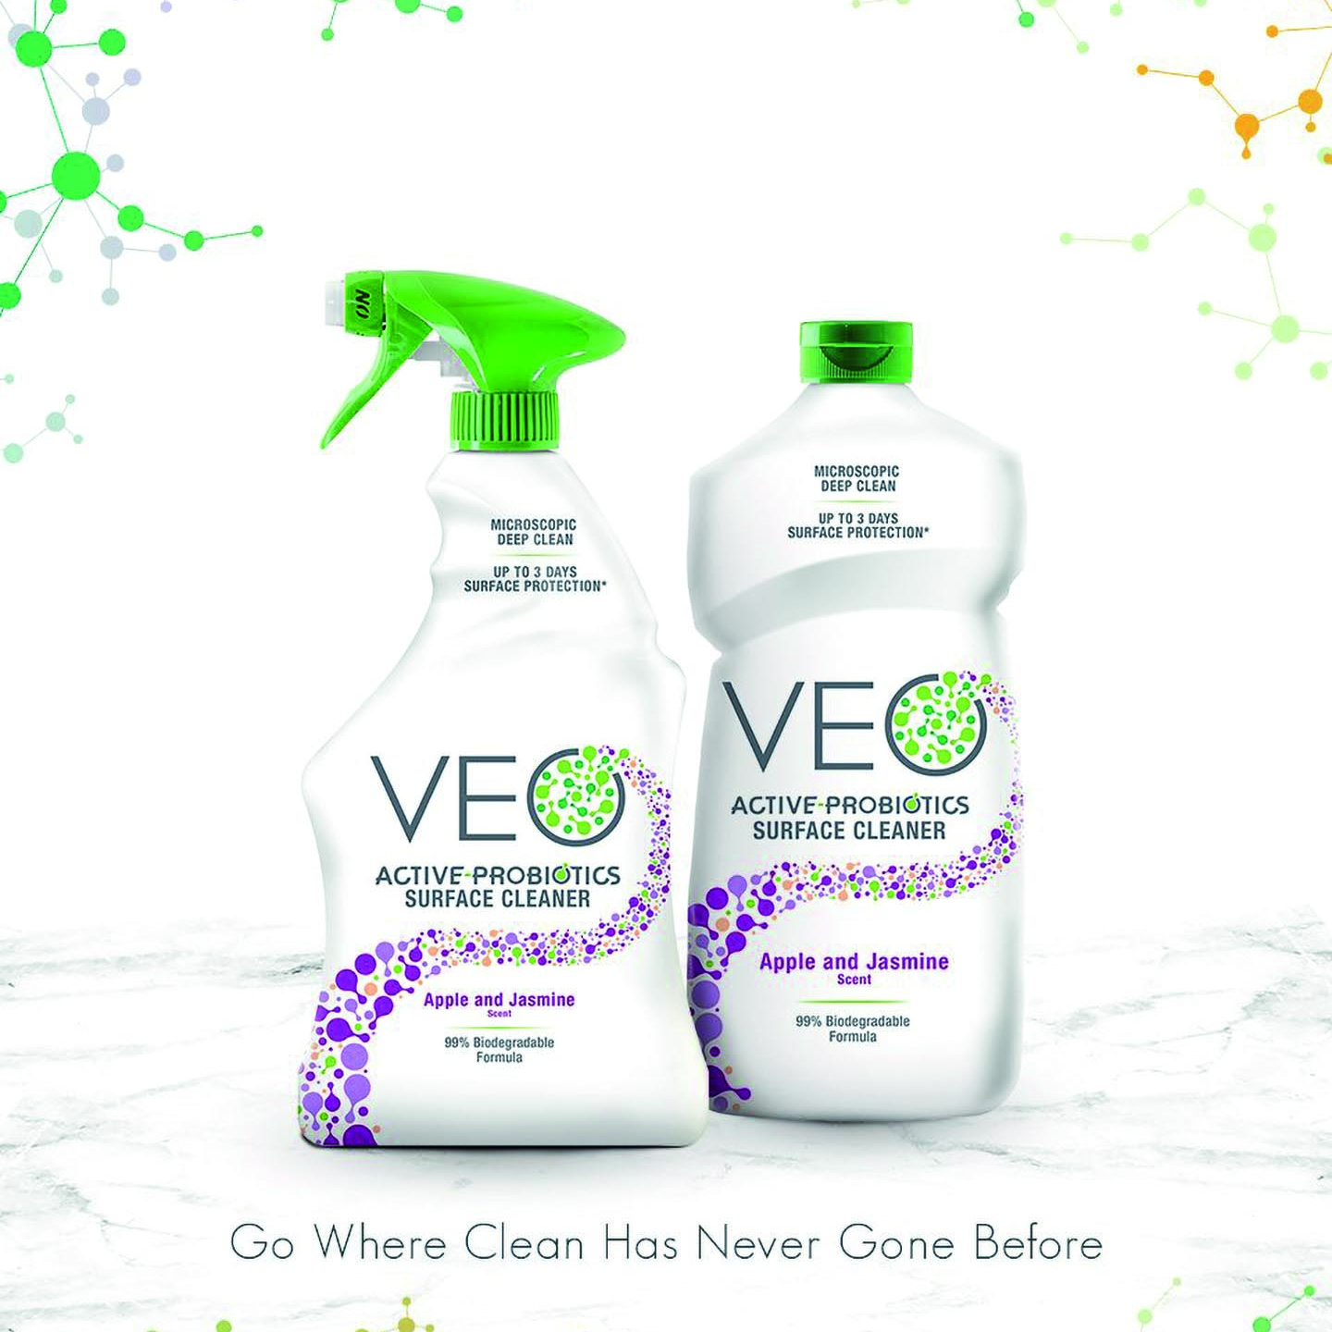
innovation case study
VEO – TOUGH ON GRIME
KIND TO THE PLANET
Active-probiotics to biodegrade dirt and grime for a deeper, long-lasting clean.
Free from chlorine bleach, formaldehyde, phosphates, and disinfectant chemicals.
Made from 100% post-consumer recycled plastic and designed to be recycled again.
Discover more here.
Notes:
For Veo, we talk as much about what’s not in it, as what is.
The 99% biodegradable formula is free from chlorine bleach, formaldehyde, phosphates, and disinfectant chemicals – and uses active probiotics similar to the live bacteria you can find insupplements for gut health.
The probiotic bacteria works on dirt for up to three days, with less environmental impact than traditional chemicals.
Veo’s bottle is made from 100% post-consumer recycled plastic, and its sleeve can be easily removed so that the bottle can be recycled again.
https://veocleaner.com/

